Slide 1


FIFA Player Information Management System
Group 10 – Division Subgroup
Wenjing CAI 116010004
Yifan LAN 116010103
Zhihao XU 117010330
Erdi GAO 117010066
Yilei TU 117010251

Slide 2
1 Introduction
Inefficient & not user-friendly
FIFA: International Football Association & Video Game
Traditional managing methods

Slide 3

2 Functions
1
Register & Log in
2
View all orders & Create new order & Check order details
3
Update user profile
5
Track vehicles & devices
4
View statistical analysis
6
Support quick messaging

Slide 4
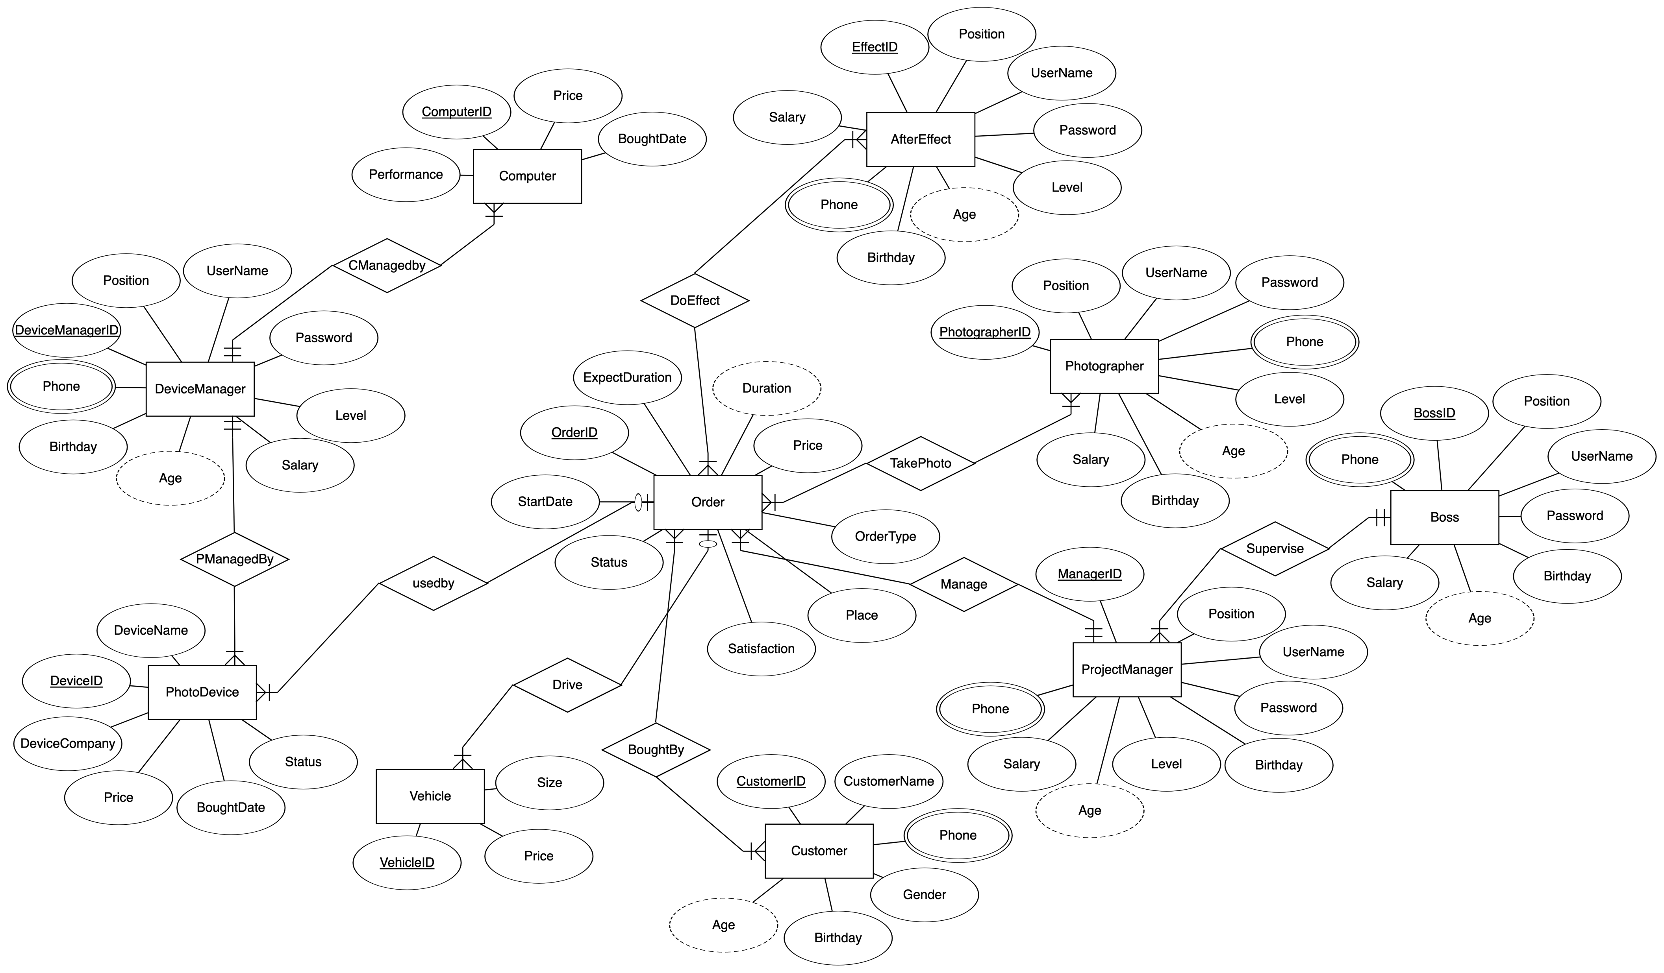
3 ER Diagram

Slide 5
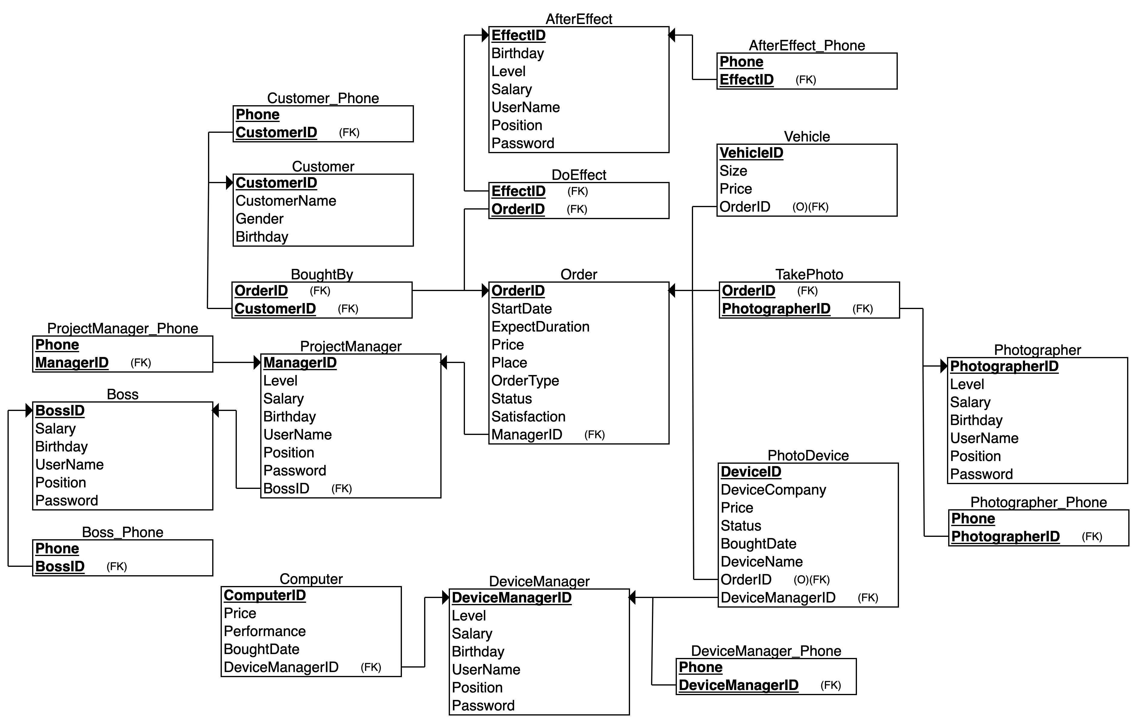
4 Relational Schema

Slide 6






5 Implementation
Front End
Back End

Slide 7
DEMO

